Slide 1
Industrializing AI with Baidu AutoDL
Haoyi Xiong, Ph.D
Big Data Lab, Baidu, Inc.

Slide 2
About the Talk
What is Baidu AutoDL?
What can we do with Baidu AutoDL?
What technical advantages could Baidu AutoDL provide?
What broader impacts and intellectual merits could Baidu AutoDL achieve?

Slide 3
About Baidu Big Data Lab
One of the six key research labs operated by Baidu, Inc.
Established under The United Nations Development Programme, Aug 2014
Currently, under the leadership of Prof. Dejing Dou
from the Department of Computer and Information Sciences, University of Oregon, Eugen, ORE
In charge of the Baidu Research efforts on
Baidu AutoDL
Federated Learning
Interpolation of Deep Neural Networks
Foundations of big data…
Prof. Dejing Dou

Slide 4
About the Speaker
Research Interests
Automated Deep Learning, Ubiquitous Big Data
Professional Experience
Tech Lead & Staff Research Scientist 2018.05—present
Big Data Lab, Baidu, Inc.
Tenure-Track Assistant Professor/Ph.D Advisor 2016.08—2010.08
Missouri University of Science and Technology (ex. UM Rolla), Rolla, MO
Postdoctoral Research Associate 2015.07—2016.08
University of Virginia, Charlottesville, VA
Education
Ph.D, Institut Mines-Télécom and UPMC Paris 6, Evry, France
MSc., Hong Kong University of Science and Technology, Hong Kong SAR, China
BEng., Huazhong University of Science and Technology, Wuhan, China
Dr. Haoyi Xiong
Personal homepage: https://sites.google.com/site/haoyixiongshomepage/

Slide 5
Deep Learning as Large-scale Industrial Applications
McKinsey research shows that deep learning can help 2/3 of corporate applications improve business performance, with an average growth of 62% in all industries.
AlphaGo vs. Lee Sedol
Internet giant started adopting large-scale deep learning techniques for their core business: e.g., Google, Baidu search and advertising; Facebook information flow
2016
2015
Baidu released her first deep learning framework for Machine Translation
Google Tensorflow became open-sourced.
The first Deep learning framework Theano released
2013
2012
AlexNet network won the ImageNet competition
Hinton leveraged deep learning to make large-scale speech recognition progress with Microsoft Research
Baidu made her first attempt at using deep learning algorithms for speech recognition and OCR
2006
2010
Hinton proposed the world first deep neural network algorithm
Theoretical breakthrough
Technological breakthrough
widely used
social influence

Slide 6

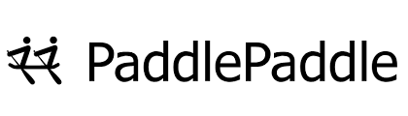


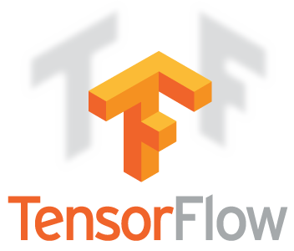
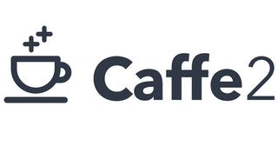


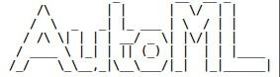
Evolution of the Deep Learning Framework
From the prestigious universities to industrial giants—The battle field moved!
Theano (2010, U Montreal), Caffe (2013, Berkeley), Tensorflow (2015, Google), MXNET (2015, AWS support), PaddlePaddle (2016, Baidu), PyTorch (2017) , Facebook), Caffe2 (2017, Facebook)
AutoDL
2010
2015
2017
2013
2016
2018

Slide 7

The Development of Baidu's Deep Learning
Won multiple international Deep learning contests, including MSMARCO
Release PaddlePaddle 3.0
Extent deep learning to recommendation system
Released PaddlePaddle Fluid
Released the world's first NMT online translation engine
Released Innovative acoustic model based on LSTM-CTC
Released Innovative general deep learning framework for NLP tasks
PaddlePaddle--The Baidu Flagship Deep Learning Platform
DNN models released for Baidu Search, and Fengchao CTR
Extent deep learning to speech recognition, OCR, etc.
Built large-scale machine learning infrastructures, models, tools and experimental platforms
2018
2017
2016
2015
2012
2013
2008

Slide 8
Baidu AutoDL as a part of PaddlePaddle Suite
Service Platform
Modules
EasyDL
AI Studio
AutoDL
Visual DL
Core Framework
PARL
PaddleRec
PaddleCV
PaddleNLP
Training Framework
PaddlePaddle
Serving
PaddlePaddle
Mobile
EDL

Slide 9
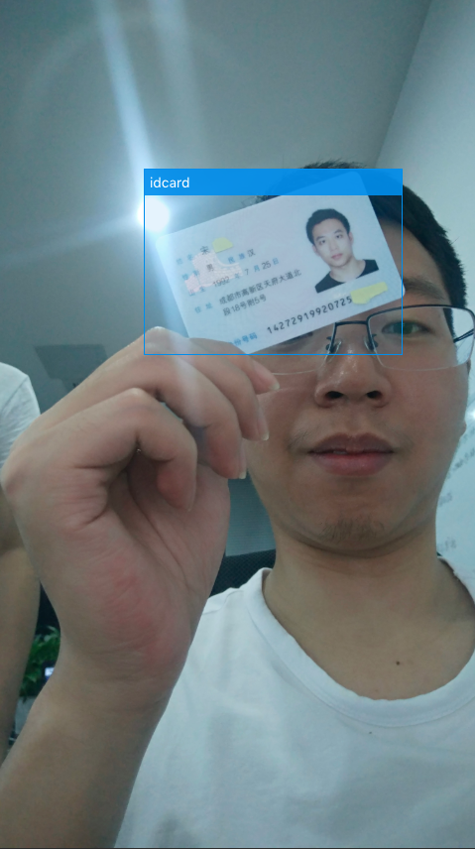

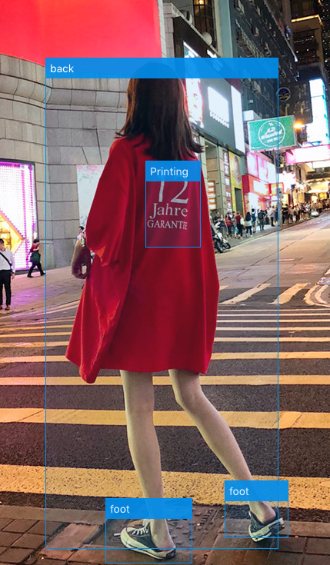
百度产品应用实例
百度产品应用实例
Some Industry Applications of-course IN CHINA
Example 1
Example 2
Long Video Summarization
Content-aware Image Extraction and Reorganization
Biometrics-Identity Co-verification
Recognizing faces with their IDs using mobile phones
Result
Result
Precision:99%+
Reducing the cost of insurance for customer verification
Precision:80%+

Slide 10

Baidu AutoDL Service Provision through EasyDL
Producing high quality models for a wide spectrum of tasks, such as image classification and object detection
Capable of handling more than 6,000 EasyDL developers designing and tuning DNNs in parallel
Picture dataset
Cloud independent
RestAPI
Dialogue dataset
Sound dataset
Video dataset
Study
Deploy
Intelligent device
local computing
Machining
Deploy
……

Slide 11
About Baidu AutoDL
Baidu AutoDL Platform
AutoDL Design – neural architecture search systems for automated DNN designs
AutoDL Transfer – automated pre-trained DNN model sourcing and knowledge transfer
AutoDL Finetuner – automated DNN training with hyperparameter optimization
AutoDL Federation – automated federated learning with horizontal/vertical separation
AutoDL Edge–automated DNN training and inference over mobile devices

Slide 12
AutoDL Design - Beyond all Manual Design Networks and
(so far all) Architecture Search Algorithms
Model | Acc. | Model | Acc.
vgg_15_BN_64 | 93 | resnet_v2_bottleneck_164 | 94.2
vgg_16 | 93.6 | wide_resnet | 95
resnet_32 | 92.5 | densenet_BC_100_12 | 95.5
resnet_44 | 93 | resnext_29_8x64d | 96.2
resnet_56 | 93.3 | shake_shake_64d_cutout | 97.1
resnet_110 | 93.5 | AutoDL | 98.03
AutoDL Design
The accuracy of the network designed by Auto DL technology is over 98%, which is higher than the networks designed by any human experts or other architecture search algorithms.
CIFAR 10 is a major image classification dataset for Benchmark

Slide 13
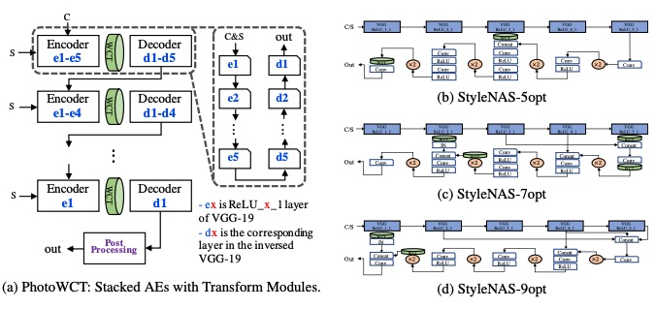
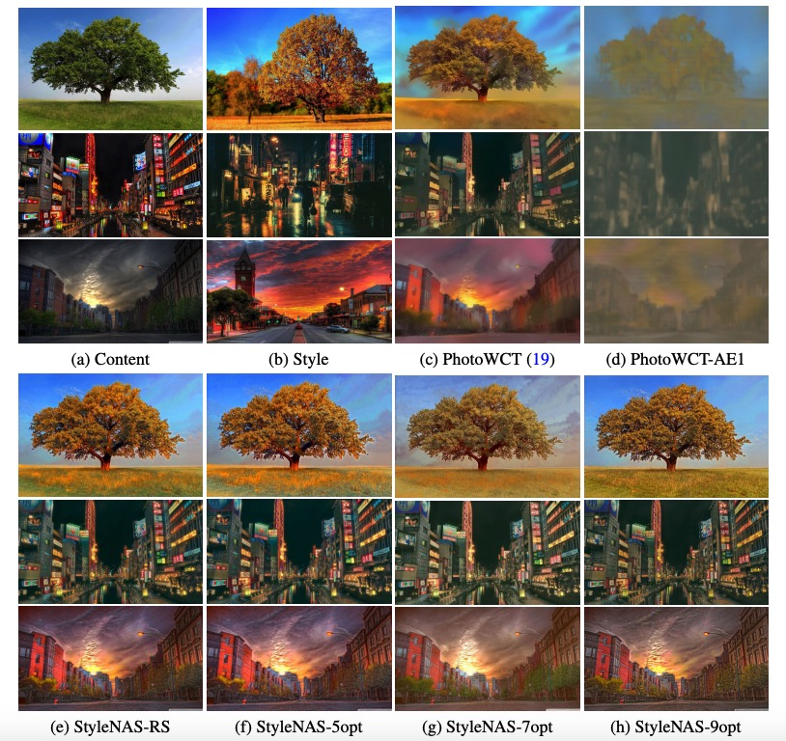
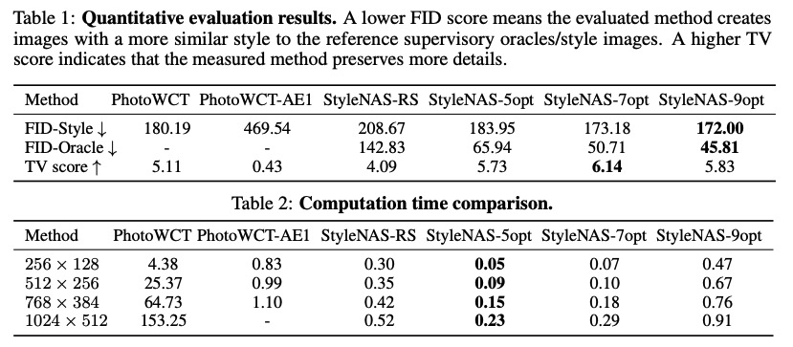
AutoDL Design StyleNAS – the World First “Design-by-Design” Style Transfer Neural Networks
StyleNAS: An Empirical Study of Neural Architecture Search to Uncover Surprisingly Fast End-to-End Universal Style Transfer Networks J An, H Xiong, J Ma, J Luo, J Huan - arXiv preprint arXiv:1906.02470, 2019

Slide 14
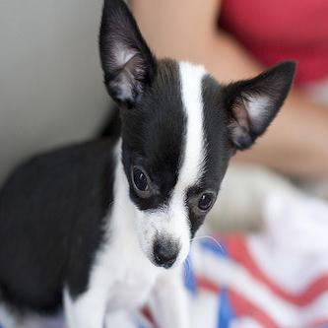
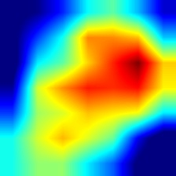
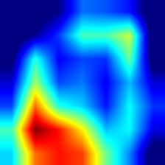
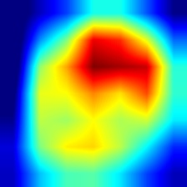
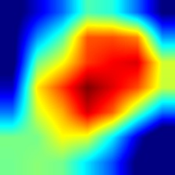
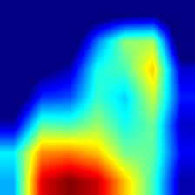
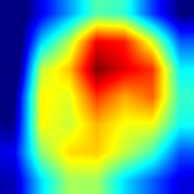
AutoDL Transfer – Pay Attentions to Features, Transfer via Attentive Knowledge Distillation
Our methods
Transfer via Knowledge Distillation of Feature Maps
Pay attention to “important” Features using weights
…
source model
weight
N feature maps
distance metric
×
Regularization loss
…
with attention
N feature maps
target model
Cross entropy loss
[ICLR'19] Xingjian Li, Haoyi Xiong*, Hanchao Wang, Yuxuan Rao, Liping Liu, and Jun Huan. DELTA: Deep Learning Transfer using Feature Map with Attention for Convolutional Neural Networks. In Proceedings of The Seventh International Conference on Learning Representations, New Orleans, LA, 2019.

Slide 15
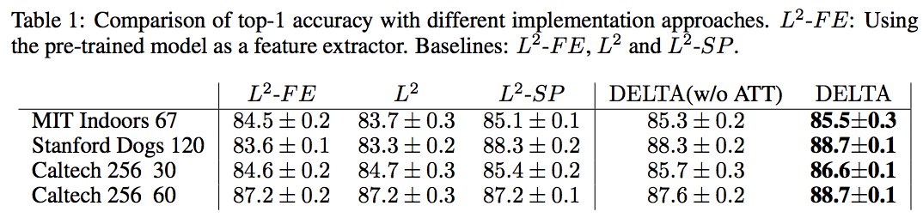
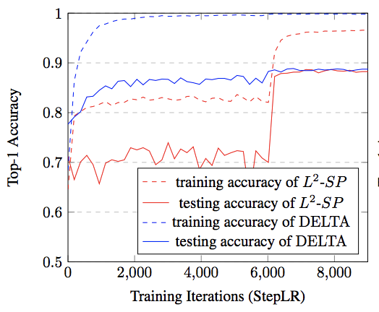
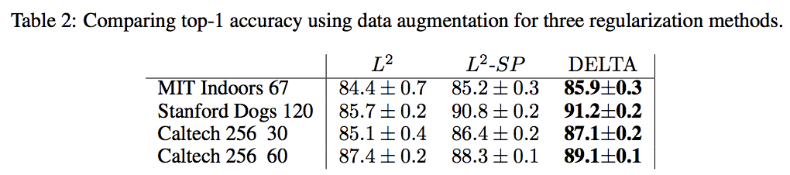
AutoDL Transfer – Pay Attentions to Features, Transfer via Attentive Knowledge Distillation
Experiments
better performance
faster and more stable convergence
[ICLR'19] Xingjian Li, Haoyi Xiong*, Hanchao Wang, Yuxuan Rao, Liping Liu, and Jun Huan. DELTA: Deep Learning Transfer using Feature Map with Attention for Convolutional Neural Networks. In Proceedings of The Seventh International Conference on Learning Representations, New Orleans, LA, 2019.

Slide 16
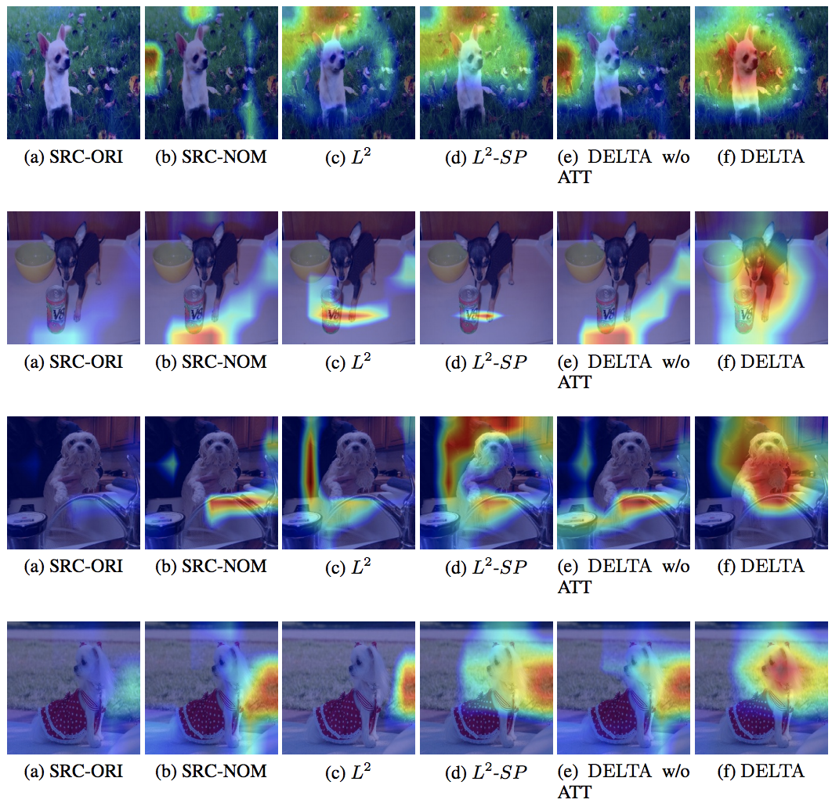
AutoDL Transfer – Pay Attentions to Features, Transfer via Attentive Knowledge Distillation
[ICLR'19] Xingjian Li, Haoyi Xiong*, Hanchao Wang, Yuxuan Rao, Liping Liu, and Jun Huan. DELTA: Deep Learning Transfer using Feature Map with Attention for Convolutional Neural Networks. In Proceedings of The Seventh International Conference on Learning Representations, New Orleans, LA, 2019.

Slide 17
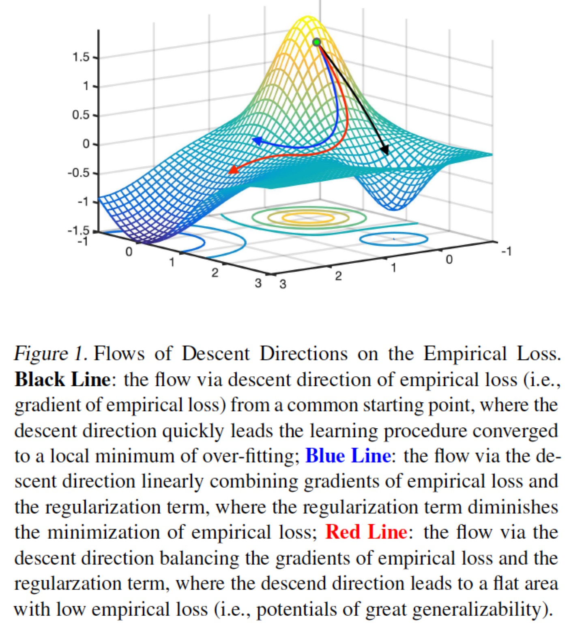
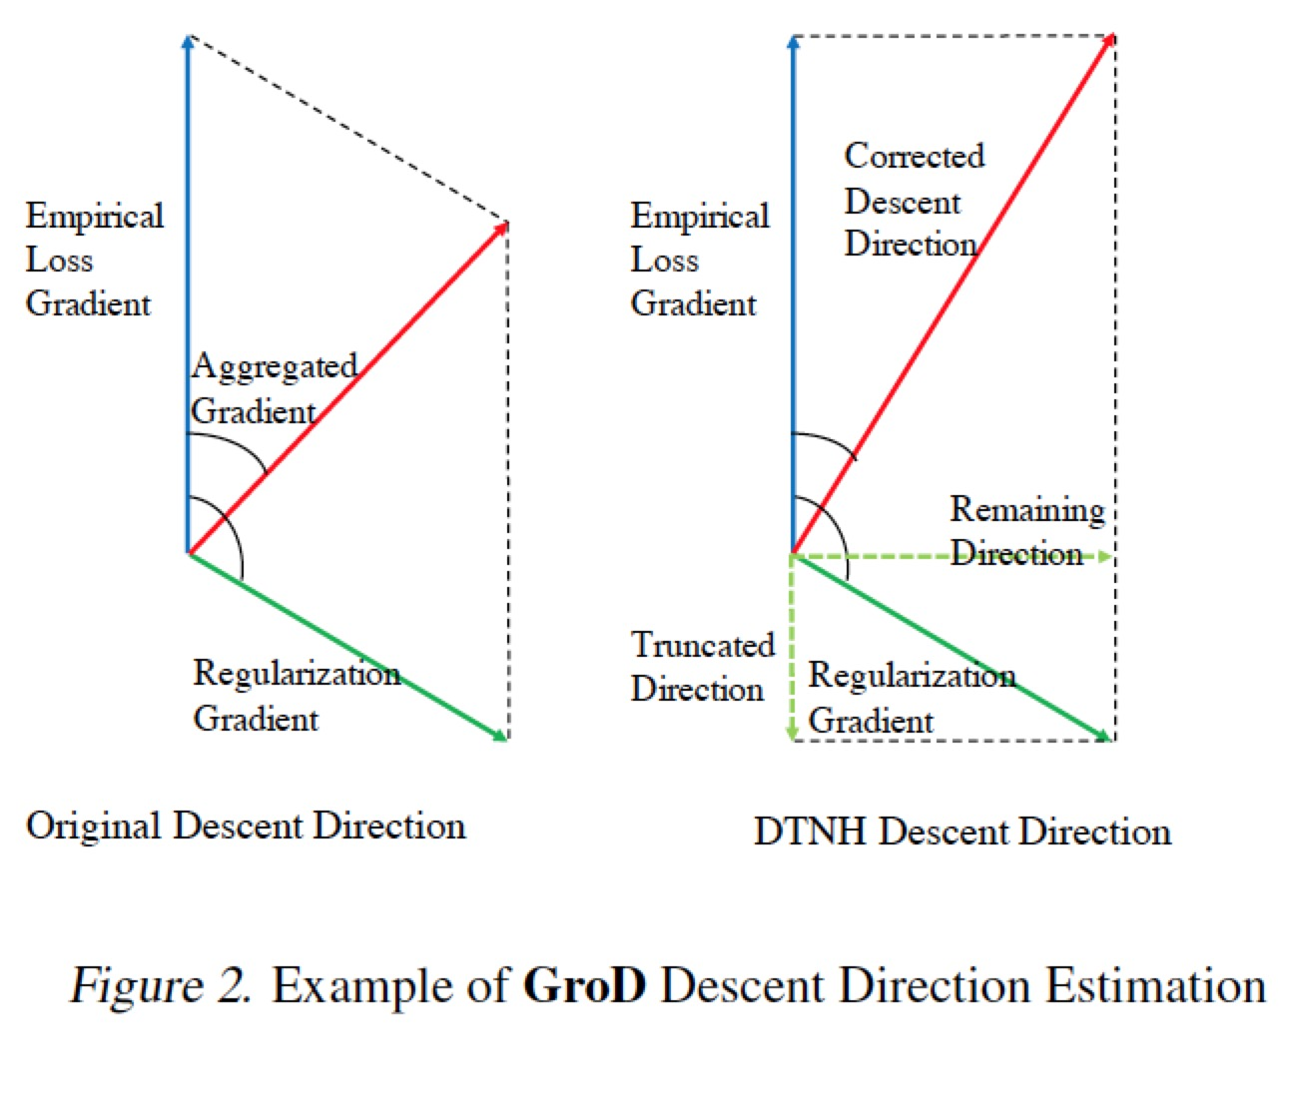
AutoDL Transfer – Make Deep Transfer Learning Never Hurt
[ICDM'19] Ruosi Wan, Haoyi Xiong*, Xingjian Li, Zhanxing Zhu, and Jun Huan. Towards Making Deep Transfer Learning Never Hurt. Proceedings of the 19th IEEE International Conference on Data Mining, 2019.

Slide 18
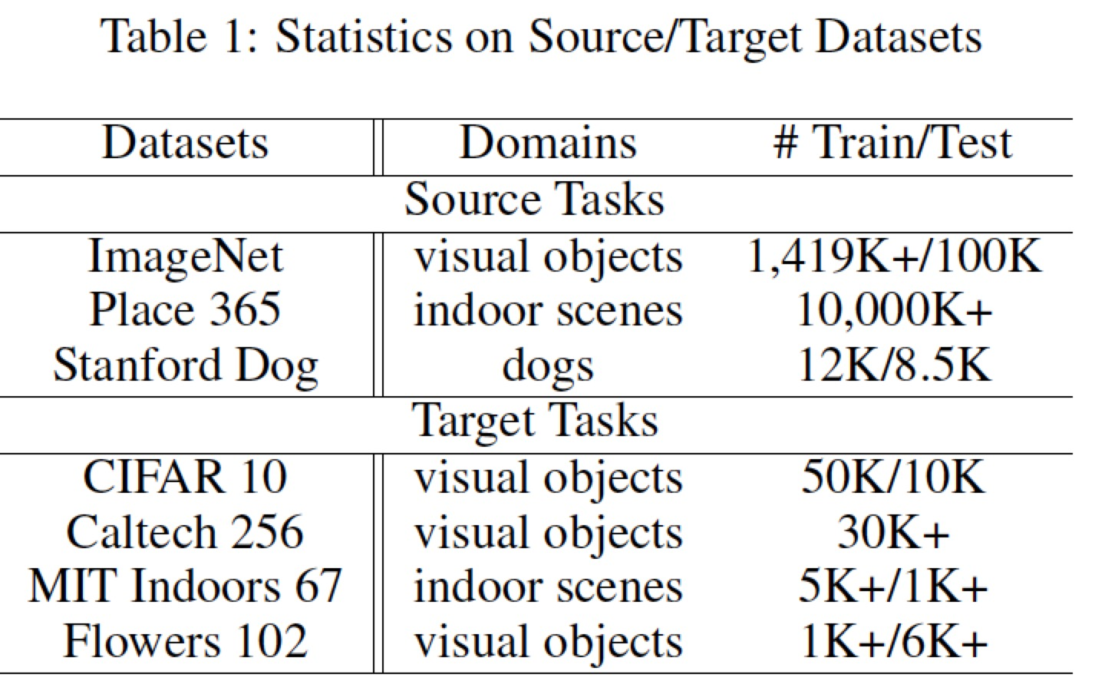
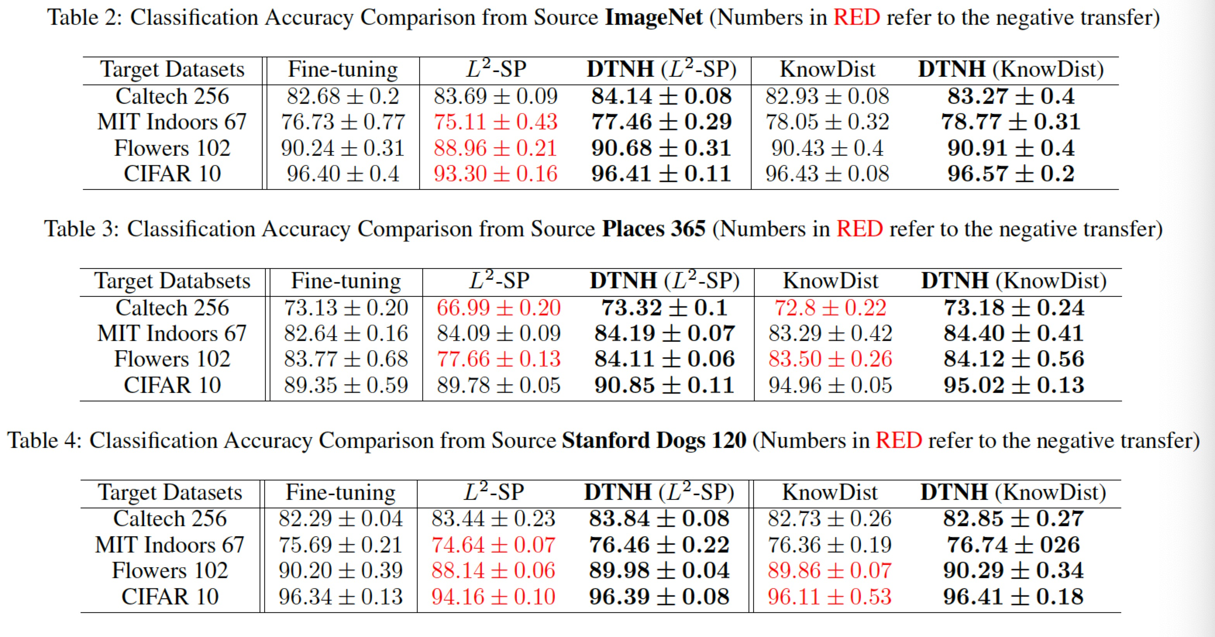
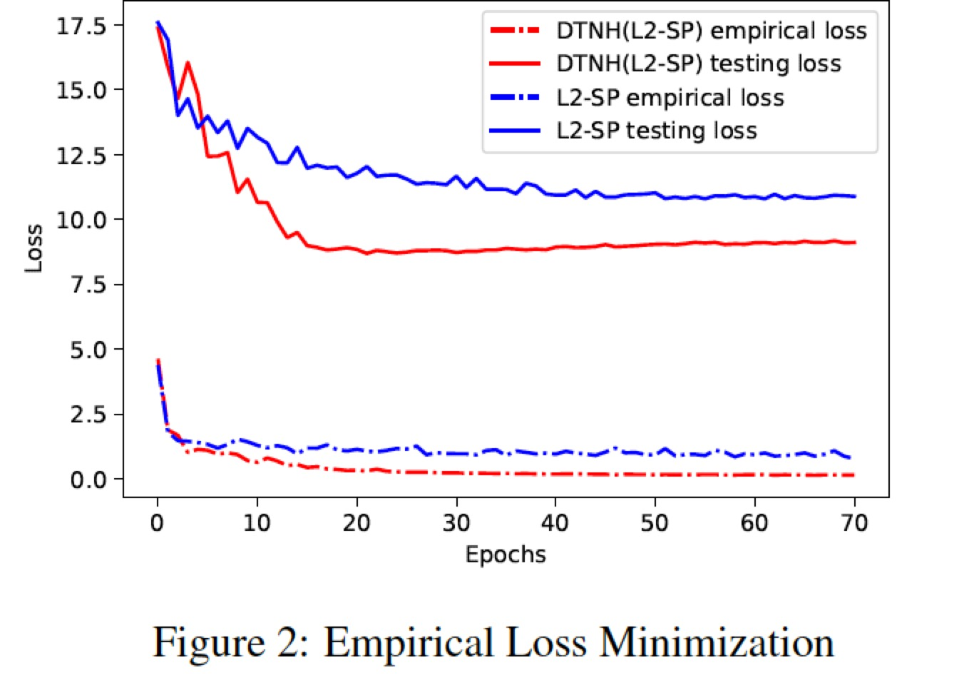
AutoDL Transfer – Make Deep Transfer Learning Never Hurt (DTNH)
[ICDM'19] Ruosi Wan, Haoyi Xiong*, Xingjian Li, Zhanxing Zhu, and Jun Huan. Towards Making Deep Transfer Learning Never Hurt. Proceedings of the 19th IEEE International Conference on Data Mining, 2019.

Slide 19
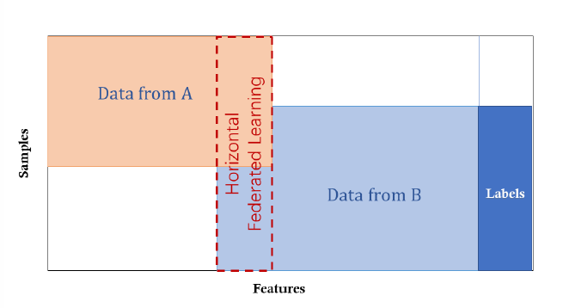
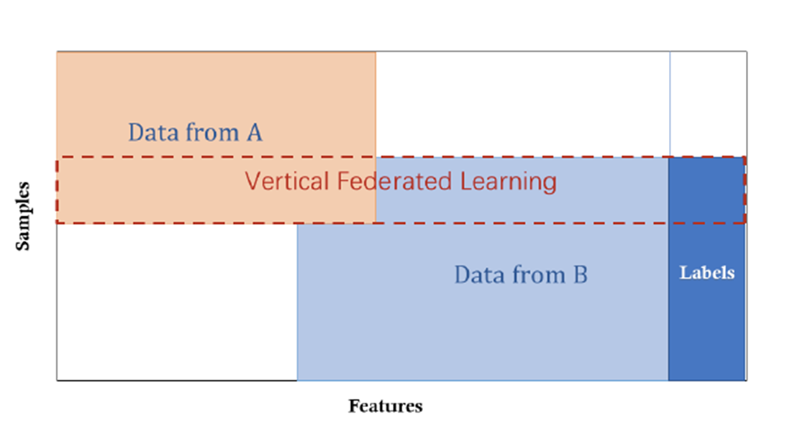
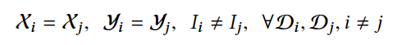
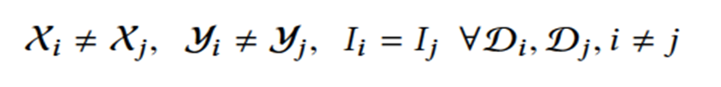
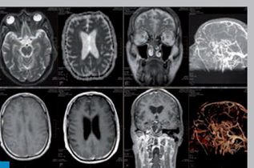
AutoDL Federation: Federated Learning with Vertical “View Separation”
Learn a model for Insurance Recommendation
With “Privacy” Protection
Medical Data
Bank Data
Insurance Data

Slide 20
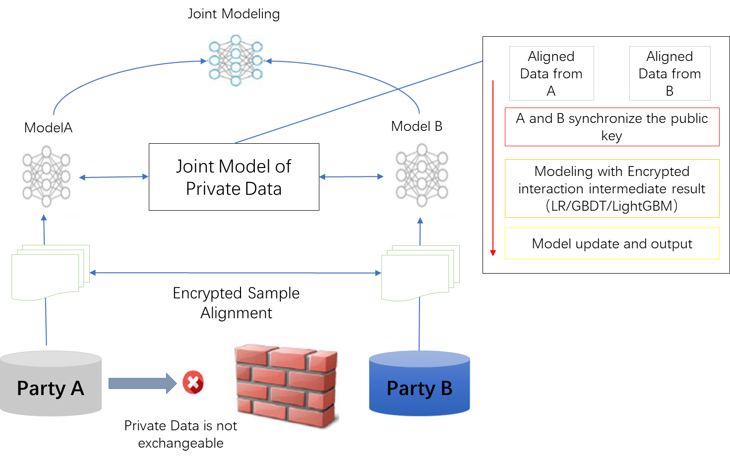
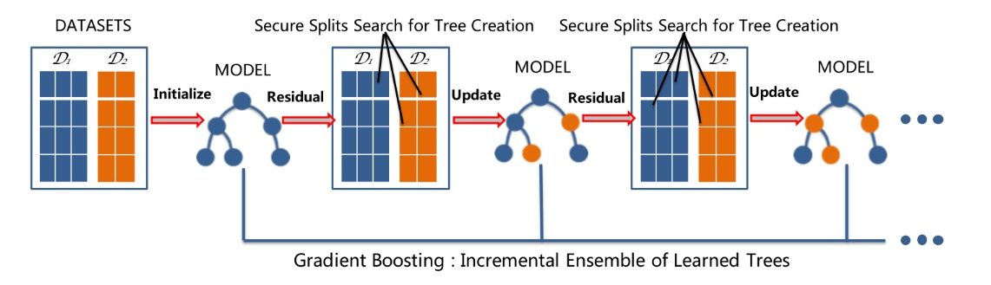
AutoDL Federation with SecureGBM Our methods - Distributed Gradient Boosting Decision Trees (GBDT) - Semi-Homomorphic Encryption (SHE) - Multi-Party Computation (MPC) - GPU + Statistical Acceleration
[BigData'19] Zhi Feng, Haoyi Xiong*, Chuanyuan Song, Sijia Yang, Baoxin Zhao, Licheng Wang, Zeyu Chen, Liping Liu, and Jun Huan. SecureGBM: Secure Multi-Party Gradient Boosting. The 2019 IEEE International Conference on Big Data, Los Angeles, CA, 2019.

Slide 21
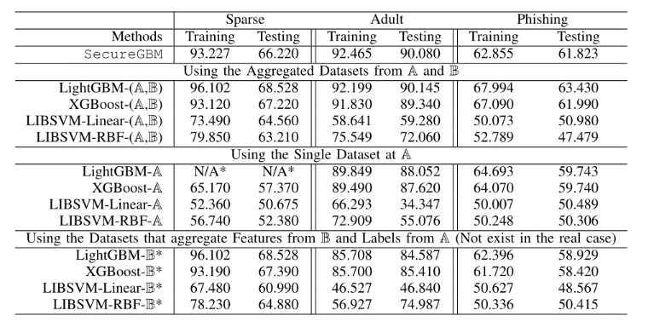
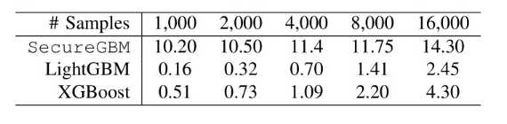
AutoDL Federation with SecureGBM
Overall Classification AUC (%) Comparison (N/A: During the experiments, LightGBM reported failure to train the model due as the features of the given datasets are too sparse to learn.)
[BigData'19] Zhi Feng, Haoyi Xiong*, Chuanyuan Song, Sijia Yang, Baoxin Zhao, Licheng Wang, Zeyu Chen, Liping Liu, and Jun Huan. SecureGBM: Secure Multi-Party Gradient Boosting. The 2019 IEEE International Conference on Big Data, Los Angeles, CA, 2019.
Time Consumption per Iteration (seconds) on a Synthesized Dataset over Varying Number of Training Samples

Slide 22
AutoDL Edge Inference – Accelerated and Energy Efficient Inference over Mobile Devices
 |  | Before Compression |  | After Compression |  | Compression Ratio
 |  | Parameters | Accuracy | Parameters | Accuracy
SoundNet on ESC-50 |  | 13.00M | 0.66 | 0.07M | 0.656 | 180
ResNet on CIFAR-10 | ResNet-18 | 11.17M | 0.9418 | 0.82M | 0.939 | 13.62
 | ResNet-34 | 21.28M | 0.9472 | 1.69M | 0.9429 | 12.59
 | ResNet-50 | 23.52M | 0.9516 | 3.97M | 0.9491 | 5.92
DenseNet on CIFAR-10 | DenseNet121 | 6.96M | 0.9513 | 1.75M | 0.9472 | 3.97
AutoDL Edge
Efficient model compression with performance/accuracy preserved for model deployment on pervasive Edge Computing devices

Slide 23

AutoDL Edge Training: Efficient Federated Deep Learning over Mobile Devices
2. Selected devices download the current model parameters
1. Server selects a sample of online devices
4. Server aggregates users' updates
into a new model
5. Repeat util convergence
3. Devices compute an update
using local training data
Yang, T., Andrew, G., Eichner, H., Sun, H., Li, W., Kong, N., Ramage, D. and Beaufays, F., 2018. Applied Federated Learning: Improving Google Keyboard Query Suggestions.

Slide 24
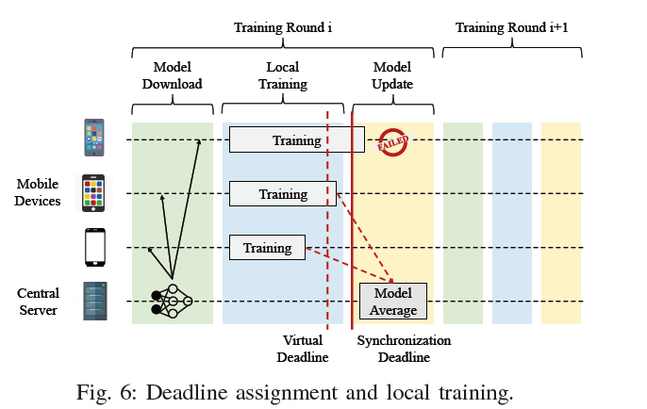
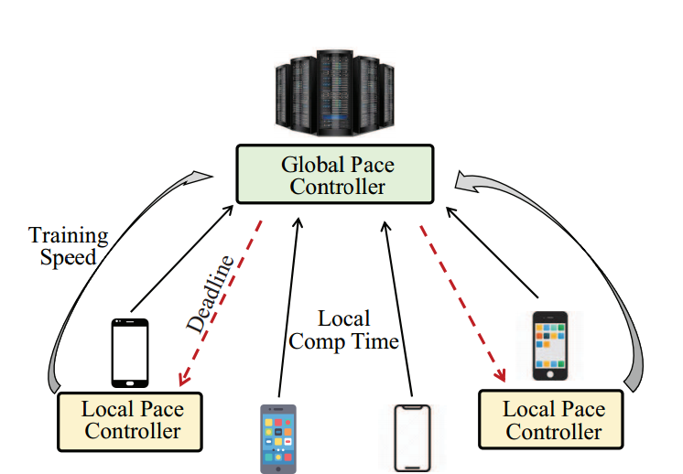
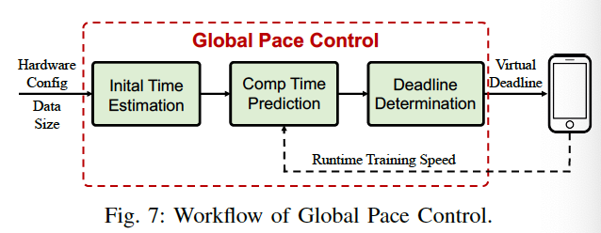
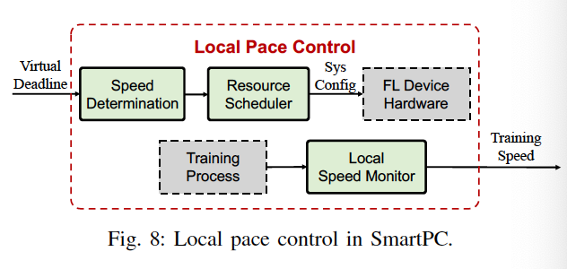
AutoDL Edge Training: Efficient Federated Deep Learning over Mobile Devices with SmartPC (Smart Pace Control)
[RTSS’19] Li Li*, Haoyi Xiong*, Zhishan Guo, Jun Wang, and Cheng-Zhong Xu. SmartPC: Hierarchical Pace Control in Real-Time Federated Learning System. In Proceedings of the the 40th IEEE Real-Time Systems Symposium, Hong Kong, China, 2019, IEEE.

Slide 25
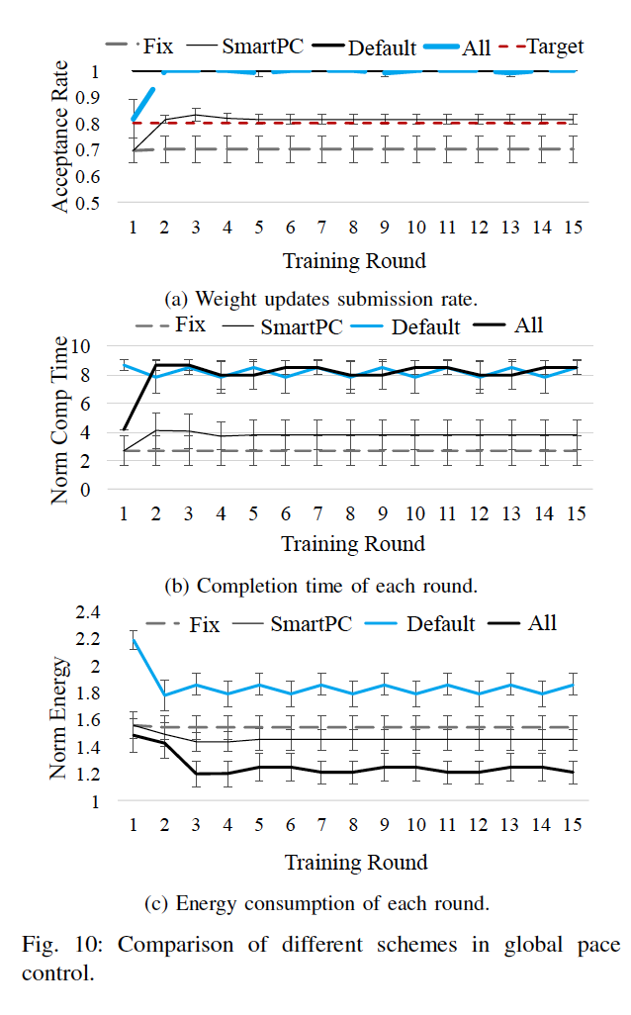
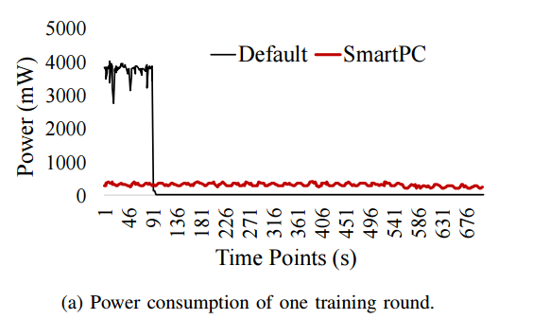
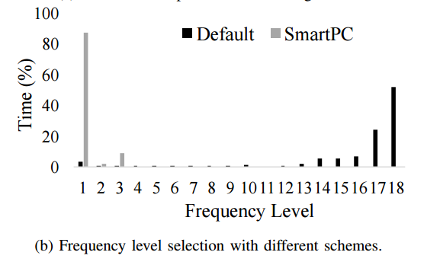
[RTSS’19] Li Li*, Haoyi Xiong*, Zhishan Guo, Jun Wang, and Cheng-Zhong Xu. SmartPC: Hierarchical Pace Control in Real-Time Federated Learning System. In Proceedings of the the 40th IEEE Real-Time Systems Symposium, Hong Kong, China, 2019, IEEE.

Slide 26
Broader Impacts and Intellectual Merits
Intellectual Merits
New infrastructure for AI Industrialization
New algorithms and research that push the frontiers of automated deep learning
Innovative applications that leverage the power of AI to do AI…
Broader Impacts
Quest for intelligence
New interface to design and implement AI
like human-readable programming language (vs. machine code) to programming
Data-driven? Human-driven? Or Model-driven? …

Slide 27
Who is Adam… Has he come?
“Creazione di Adamo” from Sistine Chapel ceiling
by Michelangelo di Lodovico Buonarroti Simoni

